Slide 1

Data Transformation Engine – Shadow Players
Arunachalam Baskar Prathapa Reddy
Ramakrishnan Sanjay Mansel

Slide 2
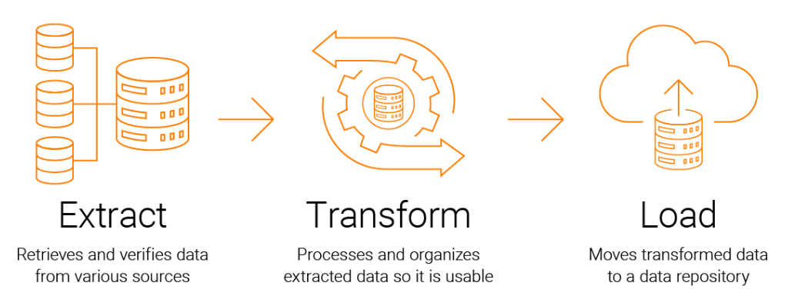
ETL Process

Slide 3
Step 1: Extract Data
Data extraction can be from multiple sources
Sources include :
APIs
DB-DB
Excel & CSV
.txt
JSON
Multiple files can be extracted from source simultaneously
Files are uploaded to engine together

Slide 4
Employee Validation Template
Emp Name
PAN
Bank Account
Aadhar
Passport
Salary slips
NDA document
Excel – 7 columns
Empname | JAppId | DocsProvided | MissingDocs | DOJ

Slide 5
Client Onboarding Template
TAN registration
Company registration
Taxes files
P/L statements
Employee count
Assests
TAN | RegNo | TaxFilesUploaded | P/L statement of Year | Emp count | Assest

Slide 6
Step 3: Data Load
The transformed final data is loaded further into data warehousing or destination products
Data extracted from the engine is analysis ready
Can be used for predictive analysis for financial services

Slide 7
Step x: Data Transform
Data transformation consists of the following steps:
Clean – Remove unwanted information to ensure data quality
Filter and sort – Apply basic rules to organize data
Join or split – Attributes can be split or joined
Advanced rules based on demographics – Rules such as currency transformation, date/time conversions, transpose etc.
Pre defined Template
Engine can be plugged into any SST product
Resulting data set can be used for analysis

